Slide 1
HTML Intro

Slide 2
Objectives
Introduce markup: elements and attributes
How browsers interpret HTML documents
Basic structure of HTML document
What do style sheets do?

Slide 3
Where do we start?
Need content
Give the document structure
Identify the different text elements
Add some images
Specify page appearance with style sheet

Slide 4
Create a file
Use your favorite text editor
Notepad++ is on the computers in lab
I use either TextWrangler, Sublime, or Taco HTML Edit on Mac (first two are free)
Doesn’t matter which you use, but it must be a TEXT editor.
The ones mentioned above are helpful with context styling
Create a new file
Add the basic HTML elements
Save it in an appropriate directory with the extension .html
Notes:
Demo

Slide 5
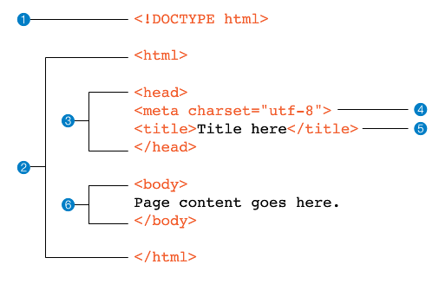
Basic file structure

Slide 6
HTML Elements
Format
<elementname> Content here </elementname>
Examples
<h1> This is a heading </h1>
<p> This is a paragraph. </p>
<p> So is this…
What happens if I separate my lines? </p>

Slide 7
What Browsers Ignore
Multiple “white” spaces
Line breaks (carriage returns)
Tabs
Unrecognized markup – ie. anything they don’t understand
Comments <!-- comment in here -->

Slide 8
Identifying Text Elements
Use HTML to add meaning and structure to the content, NOT how it should appear.
Choose elements based on what makes sense structurally
Each element has a default style
Use CSS to change how elements should appear

Slide 9
Block Elements
Examples:
Paragraphs <p>
Headings <h1>, <h2>, …, <h6>
Lists <ul>, <ol>, <li>
Treated as though they are rectangular boxes that are stacked up in the page.
Each one takes up the entire width of the web browser’s window
<p>, <h1>, <h2>, ..., <h6> have top and bottom margins
16px = 1em = height of 12pt line of text

Slide 10
Inline Elements
Examples:
<strong> or <b>
<em> or <i>
<a>
Creates an invisible box around the text being formatted
This is an <b>important</b> word
This is an important word
No border, padding or margin in or around the box

Slide 11
Inline Elements, examples
Element | Description
a | An anchor or hypertext link
abbr | Abbreviation
b | Added visual attention, such as keywords (bold)
br | Line break
cite | Citation; a reference to the title of a work, such as a book title
code | Computer code sample
del | Deleted text; indicates an edit made to a document
dfn | The defining instance or first occurrence of a term
em | Emphasized text
i | Alternative voice (italic)
ins | Inserted text; indicates an insertion to a document
kbd | Keyboard; text entered by a user (for technical documents)

Slide 12
Inline Elements, examples
Element | Description
mark | Contextually relevant text
q | Short, inline quotation
s | Incorrect text (strike-through)
samp | Sample output from programs
small | Small print, such as a copyright or legal notice
span | Generic phrase content
strong | Content of strong importance
sub | Subscript
sup | Superscript
time | Machine-readable time data
u | Text that would normally be underlined, such as formal name or misspelled word
var | A variable or program argument (for technical documents)

Slide 13
Empty Elements
Examples:
<br>
<img>
Elements do not have opening and closing tags and no content, they are just giving a directive.
Not very useful without more information.
Give information to these tags with attributes

Slide 14
HTML Elements & Attributes
Format
<tagname attribute=“value”> Content </tagname>
Or
<tagname attribute=“value”>
Examples
<a href=“www.siena.edu”> Siena College</a>
<img src=“cats.jpg” width=“200” alt=“Picture of cats”>

Slide 15
Power of Style Sheets
Most of the default styling of HTML elements are basic
To see power of style sheets:
CSS Zen Garden
All pages use exact same HTML file

